Slide 1
“Better Together” Dublin Public Library Strategy
Overview
During the Winter of 2022, the Trustees engaged the community with a focus on the Library people would like
Highlighted here is the process we took and “We Heard You”- what you told us through the surveys and listening sessions
Page 5 presents our strategy modeled after the American Library Association guidance and review of similar town’s strategies
Take a look and let us know what you think.
The Library is yours and we are committed to providing the best service possible
File- Strategy Fall 2022_final

Slide 2
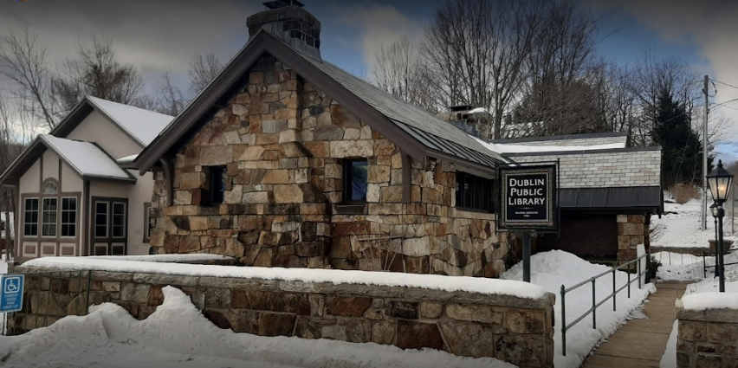
The Library of the Future Engaging Community Stakeholders
Simultaneous Forces Global Pandemic
Increased
Work From Home
Homeschooling
Rapid Town Growth
Get data
Shifting Demographic
Enabling Technology
High Speed Fiber
Library Networks
Our Response to These Forces
2022 Plan Kickoff- understand town wants and needs, survey other systems and associations
Listening- Conducted focus groups and surveys to get specific feedback, interests and direction
Strategic Plan V1.0- with input from Library Board, Staff and library association best frameworks
This Fall- Dublin Feedback and Budget
Stakeholder Listening Sessions – operational feedback, Library of the Future Strategy, initiative review and budget submission
Future Library Tour /November “Did You Know”, goals, initiatives, and engagement
2023 Budget Submission- submit best budget with understanding of value and direction
Dublin Public Library
Built in 1901 in memory of Horace Putnam Farnham

Slide 3
“We Heard You” – Community Survey 2022 Summarized Wants and Needs
Key Takeaways- Detailed Analysis Available*
Strategy Inputs
Reflects areas we should focus on- strengths and weaknesses
Provides input to Purpose, Vision, Values, Strategic Priorities and Goals
Represents a “first cut” to be built upon with our Fall “listening sessions”
Next Steps
Fall Engagement- reviewing this document with: Friends of the Library | Select Board | DubHub | Dublin Consolidated School
2023 Budget Rationale- justification for our request and future requests
Library is Underutilized Asset- 65% of the residents a few times a year or once every few years
“Library Leakage”- 54% of residents go to Keene, Peterborough and beyond. They pay fees to borrow books they can get in Dublin at no cost
Purpose of DPL Visit- we support broad uses today
Children Thrive- their programs draw most participation
Adults Want More- we need to reintroduce existing services and identify new ones
DPL Website- scored a 3.5/5 with uneven usage. Provides opportunity to continue to make it the “first stop”
Better Together- Lifelong learning and other themes are shared with the DubHub. Partnering provides opportunities to more broadly engage the 65%
* Detailed survey analysis, insights and opportunities are available

Slide 4
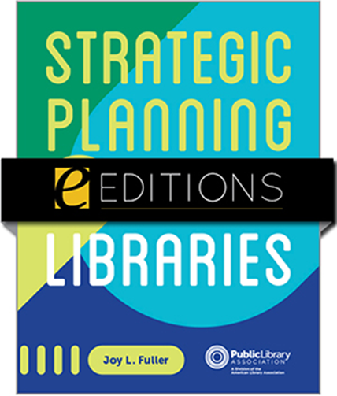
Strategy 101- Understanding the Building Blocks Maximizing Community Impact/Alignment
Purpose Verb Statement
Strategic Priorities
Why do we exist?
Who do we serve?
What we do?
Derived from subcommittee working sessions and input from:
Strategic Planning for Public Libraries, American Library Association, 2021
Top Seven Trends Influencing Libraries (STEEPED)
ALA Analysis – click here
Other library strategies driven by external consultants
Jaffrey
Sunapee
Nashua
Selected Initiatives
Vision
Future Aspirations
Identify specific programs
Provide basis for feedback
Refines how library operates
How we are going to operate to address communities hopes and dreams?
Goals
Operational Metrics
Values
Shared principles that align with community
Specific results linked to initiatives
Linked explicitly to Purpose and Vision
Input for maximizing effectiveness

Slide 5
DPL Strategy on a Page Taking Engagement to Next Level
Strategic Foundation
Strategic Priorities- Proposed Top Initiatives
Purpose
Communicate library direction and services concisely using best channels
Advocate- broad direction
Website- specific activities, dates and times: near real-time
Newsletter- specific updates
Facebook
Introduce innovative resources and services for all patrons
Propose - Invites community members to share their interests
Design- develop programs that satisfy needs and engage further
Deliver – offer virtual and on-site programs as needed
Assess- collect feedback and refine programs and
Offer “Anytime Anywhere Access”/Always Open deliver targeted content virtually via high-speed fiber
Website as the first stop
Library for the second stop
Optimize Experience (new and historic) for programs, patrons, and community members
Best Resources- Great place to work- promote staff development for personal growth while best-serving patrons
Offer all residents a center for lifelong learning, programs and information when and where needed
Vision
To be a welcoming part of the community. To provide access to information and ideas to: learn, discover, create and connect
Values
Access
Equity
Openness

